Slide 1
E-Farming Market
Group No : 17
Group Members:
Anuj Bhure Gaurav Nande
Shirish Ahire Kharanshu Wanare

Slide 2
Introduction
There is a marginal number of small farmers in India. It is difficult for these farmers to reach big markets. Only big farmers can avail the facility of the market. This hampers the growth of small farmers. Also, these results inadequate supply in the market.
The main objective of this project is building a website which will help farmers from Indian villages to sell their products to different cities. Thus, any small farmer will reach to many sellers and customers. Suppose some village farmers want to use this facility and want to learn how is it possible and how they can use e-farming market to sell their products, they must have basic knowledge of computer, then they can directly register in the site and sell their product online. On the other side, buyers can also register and buy products as per their needs.

Slide 3

Architecture
FrontEnd
ReactJS Components
CSS, Bootstrap:
Styling
Server Layer
SpringBoot Maven: Response Handling, Business Logic, Database Operations
Database
MySQL: To access and Store Data
JSON:
Data Inter-change
Request
Response

Slide 4
Flow of Data
User will Register himself and create account on this portal.
Login credentials with Roles are stored.
Farmer can upload their products on this portal.
That products will get visible to both farmers and wholesalers.
Wholesaler will order the product or add it to cart and then place order and can remove product from the cart.
Placed order details will be provide to the transporter to receive the products from farmer and deliver the products to wholesaler.
After delivery, the wholesaler can rate the product and give the feedback.
Both farmer and wholesaler can update and delete their profile.

Slide 5
Data base and Keys and Constraints
Table Name | Primary Key | Foreign Keys
User | uid (PK)
Farmer | fid (PK) | uid(Fk references User(uid))
Wholesaler | wid (PK) | uid (FK references User(uid))
Farmer_product | fp_id (PK) | fid(FK references Farmer(fid)) pid (FK references Product(pid)),cid (FK references Categories(cid))
Products | pid (PK) | cid (FK references Categories(cid)).
Categories | cid (PK)
Order | oid (PK) | wid(FK references Wholesaler(wid).
Order_item | oi_id (PK) | oid (FK references order(oid)),pid (FK references product(pid)),fid(FK references Farmer(fid)),tid(FK references Transporter(tid).
Transporter | tid (PK)

Slide 6
Technologies Used
Spring Boot Maven: Java-based framework for fast application development with built-in tools. Build tool that automates tasks like compilation and dependency management.
MySQL:
Open-source database system for storing and managing structured data.
ReactJS:
JavaScript library to build dynamic user interfaces for web apps.
JSON (JavaScript Object Notation):
Lightweight data format for easy exchange between server and web app.
CSS (Cascading Style Sheets):
Stylesheet language to design and layout HTML elements.
Bootstrap:
Front-end framework for creating responsive web designs efficiently.

Slide 7
Roles and Responsibilities of User
Farmer Module
Farmer can register and create his own account.
E-Farming Market System provides the function which allows Farmer to publish his products.
He will be able to browse existing Market price.
The Farmer will be able to learn the technique how to use e-farming market system.
He will be able to modify information of his products.
The Farmer could find what are pricing of others Farmers crop.
Providing “Pay-Back System” in case of dissatisfactions.
Wholesaler Module:
He can register and create his own account.
E-Farming Market System provides the function which allows wholesaler to find out the crops information.
And could find the price all over the country state wise, price wise, and category wise.
Providing “Pay-Back System” in case of dissatisfactions.
He will be able to give feedback and rating about the product

Slide 8
Admin Module
E-Farming Market System should provide all function to admin how to handle the System.
What are the farmers and buyers are using this system and are they authorized.
Could able to know all the Transaction.
Can manage accounts of all users.

Slide 9
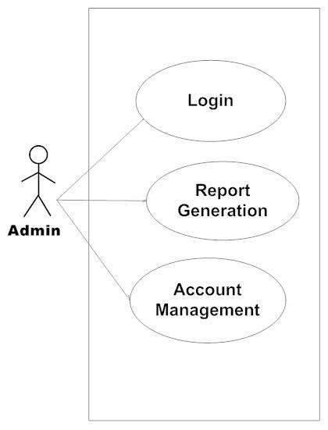
Use Cases
Admin

Slide 10
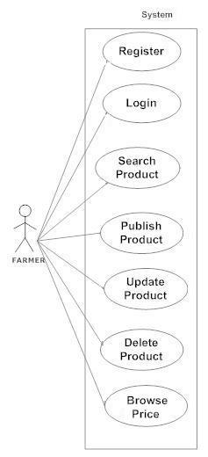
Use Cases
Farmer :

Slide 11
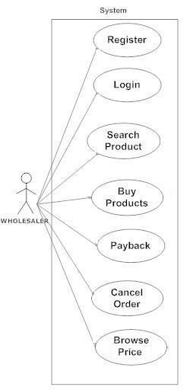
Use Cases
Wholesaler

Slide 12
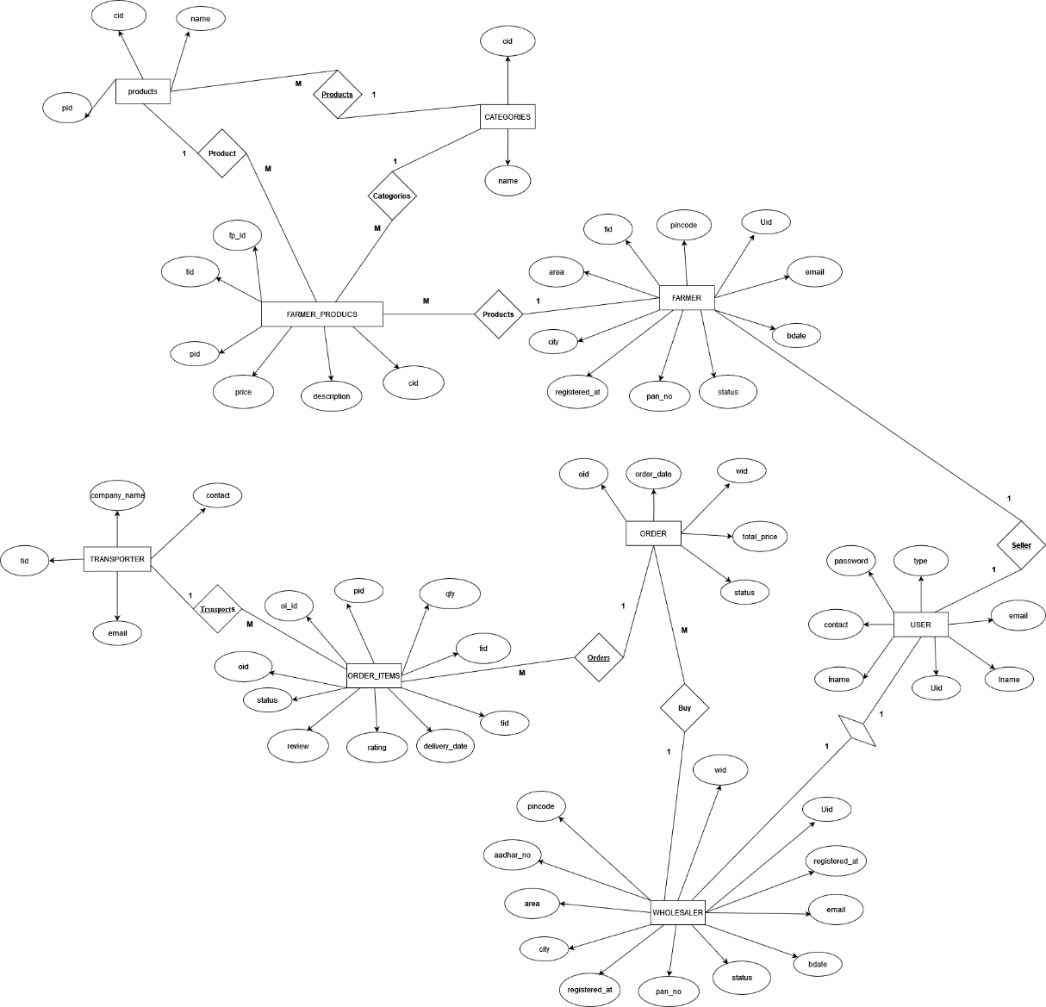
E-R Diagram

Slide 13
Work Distribution
Kharanshu Wanare : Implemented the Admin use case using .NET.
Gaurav Nande : Implemented the Farmer use case using ReactJS.
Shirish Ahire : Implemented Wholesaler use case ReactJS.
Anuj Bhure : Implemented Database creation, validation and REST API using Springboot.
Stages at which Coordination was needed :
Most of the coordination was needed when complete UI needed to be rendered using React and writing, mapping entities.
Everyone coordinated when setting the relationships between the entities.

Slide 14
Future Scope
Future Scope: Online Marketplaces: E-farming platforms and online marketplaces specifically designed for agricultural products could gain prominence. These platforms could connect farmers directly with consumers, reducing the need for intermediaries and potentially increasing profits for farmers.
Transparency and Traceability: Consumers are becoming increasingly interested in the origin and quality of their food. E-farming platforms might integrate systems that provide detailed information about the products being sold, including their journey from the farm to the consumer's table.
Global Reach: E-farming could enable farmers to reach a wider customer base beyond their local markets. This could be particularly beneficial for specialty or niche products that have a limited market in their immediate vicinity.
Challenges: E-farming might face challenges such as ensuring reliable and affordable access to the internet in rural areas, addressing cybersecurity concerns, and adapting to changing consumer preferences.

Slide 15
Thank You
Git hub Link :
https://github.com/AnujBhure/E-Farming_Market.git

